Slide 1

New York State Tourism Industry Association
AI Academy
Prompt Pack Your Day
Practical ways to make AI more useful
and your content more authentic
October 28, 2026
Notes:
Prompt Pack Your Day
NYSTIA AI Academy Webinar Outline and Demo Prompts
Practical ways to make AI more useful—and your content more authentic
Colleen Senglaub | Travel Alliance Partnership
October 28, 2026 | 10:00–11:00 a.m. Eastern
Example destination: The Adirondacks. Use a fall getaway for couples as the illustrative brief throughout. This is a teaching scenario, not a claim about current foliage, availability, or conditions. Use only the approved materials loaded into the demo project for destination facts.
Delivery plan: 44 minutes of planned content, 6 minutes of flexible time, and at least 10 minutes of Q&A. Run one main live blog demonstration, show a prepared itinerary, and repurpose an approved blog excerpt live.
Preparation checklist
Choose one Adirondacks base community and a small set of nearby experiences from approved materials before rehearsal. Confirm the source set supports the fall scenario; do not imply live foliage or availability.
Create the Adirondacks Content Demo project and load the sources, writing samples, brief, and approved blog excerpt. Use only material appropriate to show publicly.
Prepare the itinerary and its reviewed revision. Save the blog and repurposing outputs as backups.
Prepare the reusable prompt or skill example. Do not build or install a skill during the webinar.
Keep demo prompts in a separate open window for copying. Replace any needed fields before going live; [BLOG LINK] may remain visibly labeled as a placeholder.
Rehearse once with a timer. If a response stalls, move to its saved output and explain the same decisions.
Keep the itinerary as a prepared walkthrough. Shorten plugins and agents first if time runs long. Protect Q&A.

Slide 2
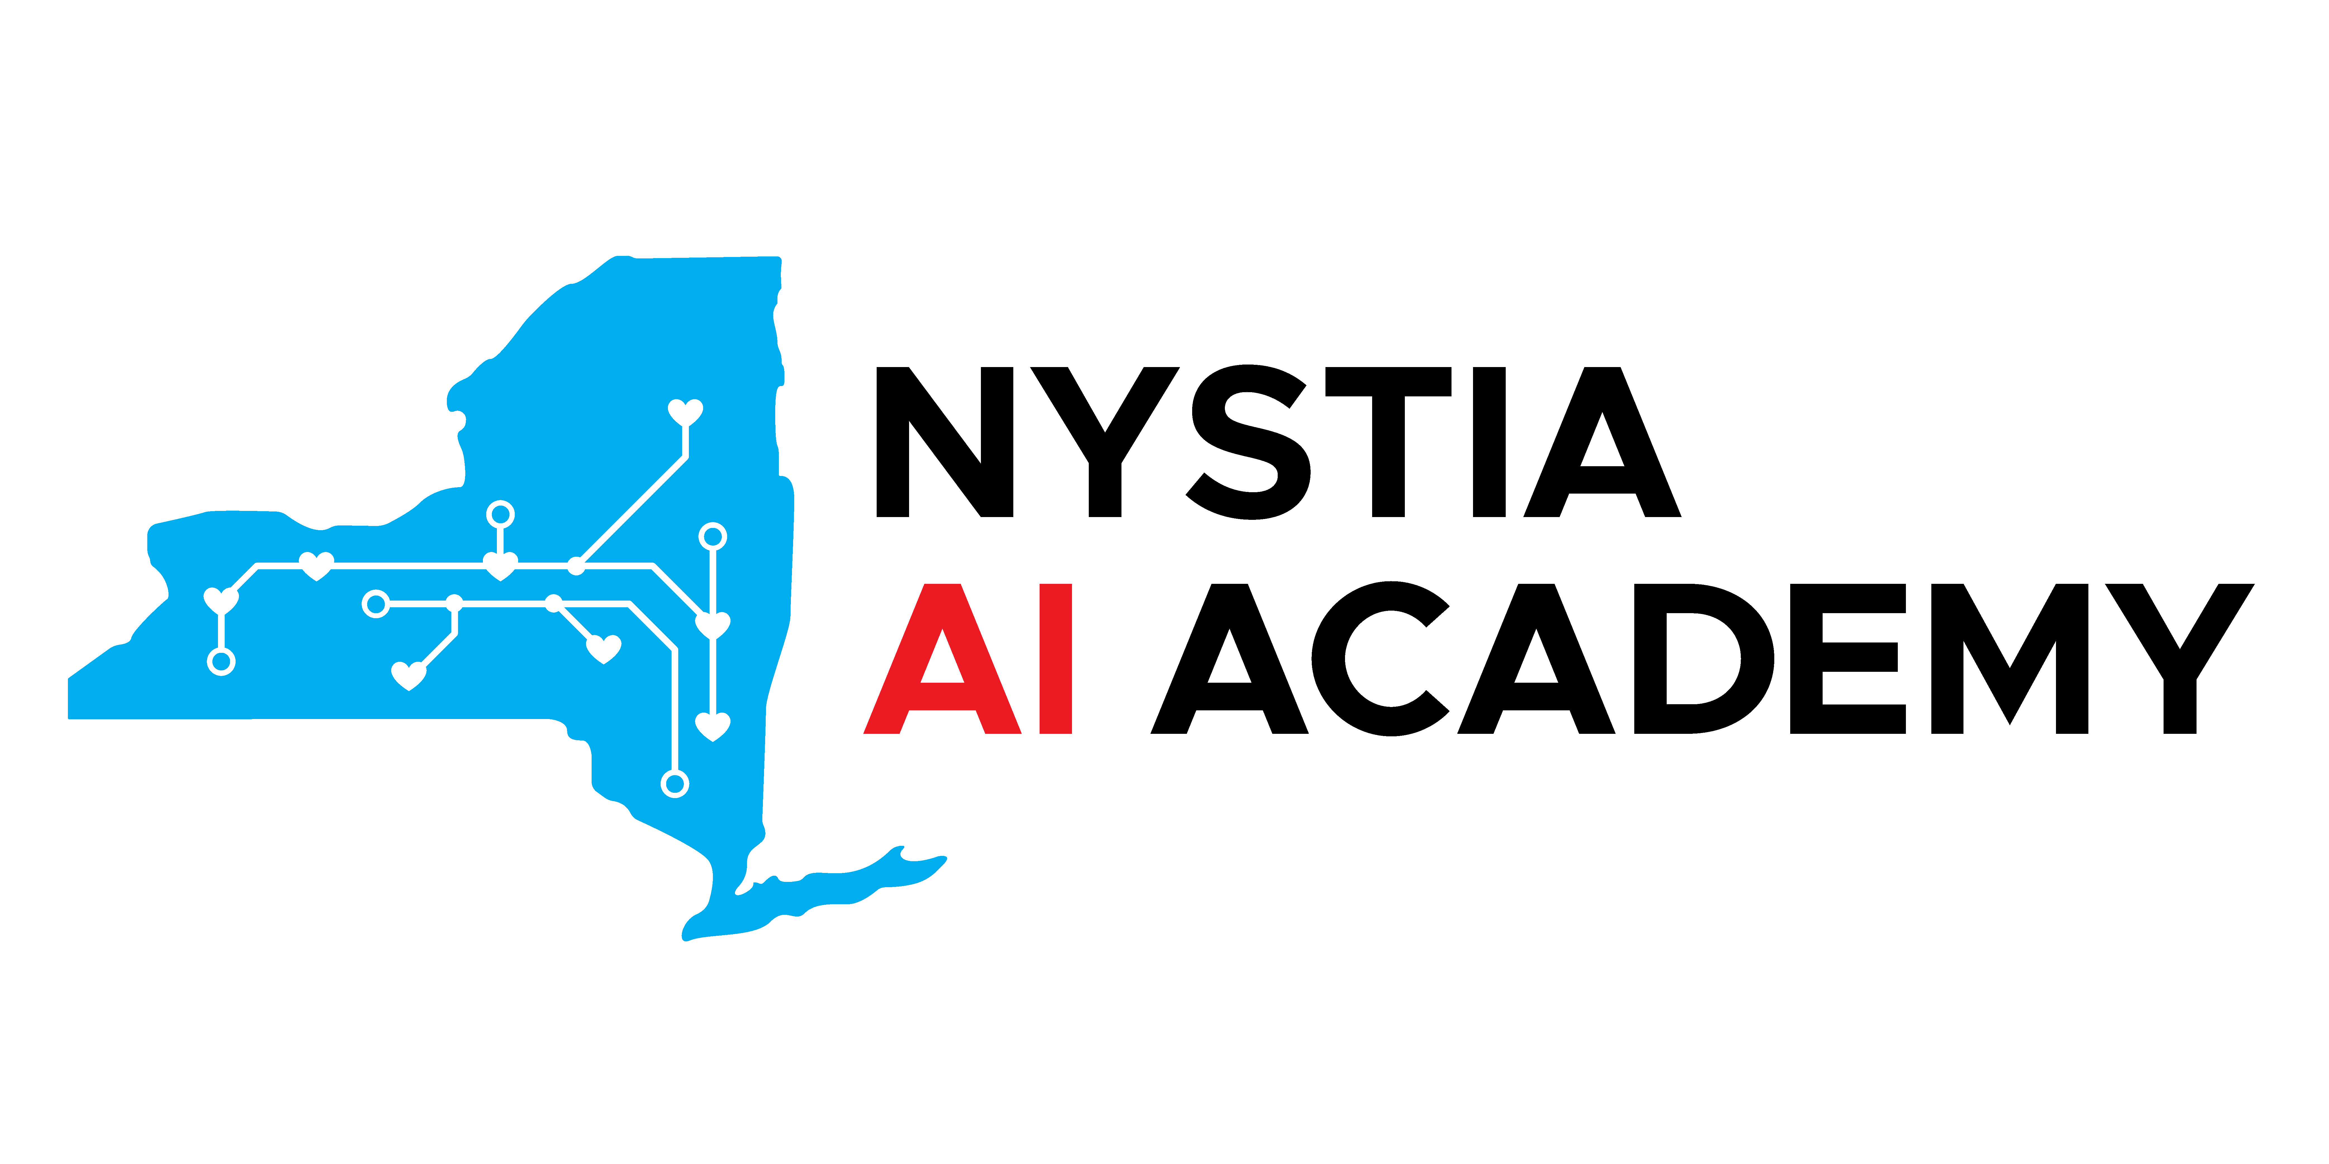
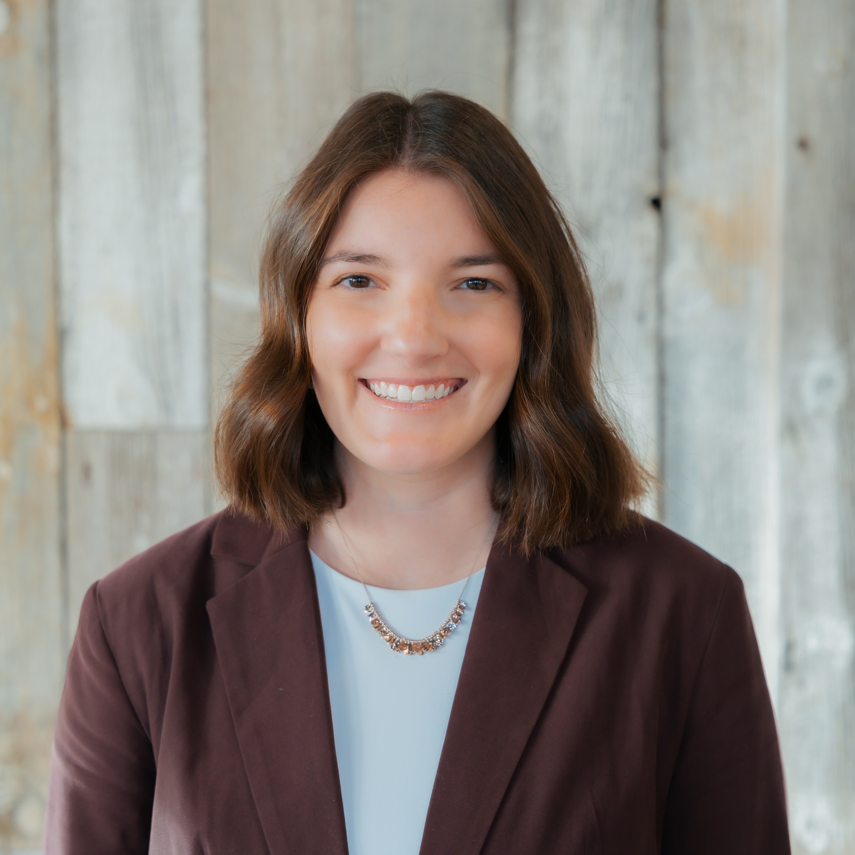

Colleen Senglaub
Digital Account Manager
Travel Alliance Partnership
Tourism marketing and practical AI workflows
IN THE CHAT
What task do you keep giving AI
the same instructions for?
NYSTIA
AI Academy | Prompt Pack Your Day | Travel Alliance Partnership
2
Notes:
1 Welcome and goals
10:00–10:03 a.m. | Elapsed 00:00–03:00 | 3 minutes
Briefly introduce your work at TAP. Include any host introduction in these three minutes.
Opening chat question: What task do you find yourself giving AI the same instructions for over and over?
Explain the goal: Build a repeatable process using an Adirondacks example, with sources, reusable instructions, and human review.

Slide 3
Today’s Session
01
Clearer prompts
Your six-part framework
02
Useful background
Source material, voice, and Projects
03
Repeatable workflows
Blog, itinerary, and content repurposing
04
Review and reuse
Save what works, check the output, and ask questions
NYSTIA
AI Academy | Prompt Pack Your Day | Travel Alliance Partnership
3
Notes:
10:02–10:03. Preview the flow. 44 minutes planned content, six minutes flexible, at least ten minutes Q&A. Use the same Adirondacks scenario across demos.

Slide 4
Your Prompt Framework
01
02
03
Set the scene
What
Who
Role and organization
Task, goal, and desired output
Audience and visitor needs
04
05
06
Details
Instructions
Resources
Relevant facts and constraints
Voice, format, length, and gaps
Approved sources and examples
NYSTIA
AI Academy | Prompt Pack Your Day | Travel Alliance Partnership
4
Notes:
2 Your six-part prompt framework
10:03–10:09 a.m. | Elapsed 03:00–09:00 | 6 minutes
Set the scene: Tell AI its role and the organization it supports.
What: Define the task, goal, and desired output.
Who: Identify the audience and what they need.
Details: Supply relevant context, facts, and constraints.
Instructions: Specify voice, length, format, and how to handle gaps.
Resources: Provide approved sources and writing examples.
Before prompt for the slide
Write a blog about a fall trip to the Adirondacks.
Stronger prompt showing all six parts
Set the scene: You are a tourism content writer supporting Adirondacks destination marketing.
What: Create an outline for a blog that helps readers plan a two-day fall getaway.
Who: Couples who enjoy scenic outings, local food, and a relaxed pace.
Details: Focus on one base community and nearby experiences supported by the supplied sources. Include no more than three main activities per day.
Instructions: Use a warm, practical voice grounded in specific details. Avoid generic travel phrases. Ask about missing essentials before drafting; flag unsupported information.
Resources: Use only the approved destination materials and writing samples in this project. Identify the source for each proposed experience. If you cannot access a source, tell me.
Presenter note: Show the contrast on slides; do not run both prompts live. Reuse the stronger prompt during the blog demo. Explain that audience and pace are illustrative choices for this exercise, not researched audience findings.

Slide 5
Example
What not to do:
Improved prompt:
“Write a blog about a fall trip to the Adirondacks.”
You are a tourism content writer supporting Adirondacks destination marketing. Create an outline for a blog that helps readers plan a two-day fall getaway for couples who enjoy scenic outings, local food, and a relaxed pace. Focus on one base community and nearby experiences supported by the supplied sources, with no more than three main activities per day. Use a warm, practical voice grounded in specific details, and avoid generic travel phrases. Ask about missing essentials before drafting, and flag unsupported information. Use only the approved destination materials and writing samples in this project, and identify the source for each proposed experience. If you cannot access a source, tell me.
NYSTIA
AI Academy | Prompt Pack Your Day | Travel Alliance Partnership
5
Notes:
2 Your six-part prompt framework
10:03–10:09 a.m. | Elapsed 03:00–09:00 | 6 minutes
Set the scene: Tell AI its role and the organization it supports.
What: Define the task, goal, and desired output.
Who: Identify the audience and what they need.
Details: Supply relevant context, facts, and constraints.
Instructions: Specify voice, length, format, and how to handle gaps.
Resources: Provide approved sources and writing examples.
Before prompt for the slide
Write a blog about a fall trip to the Adirondacks.
Stronger prompt showing all six parts
Set the scene: You are a tourism content writer supporting Adirondacks destination marketing.
What: Create an outline for a blog that helps readers plan a two-day fall getaway.
Who: Couples who enjoy scenic outings, local food, and a relaxed pace.
Details: Focus on one base community and nearby experiences supported by the supplied sources. Include no more than three main activities per day.
Instructions: Use a warm, practical voice grounded in specific details. Avoid generic travel phrases. Ask about missing essentials before drafting; flag unsupported information.
Resources: Use only the approved destination materials and writing samples in this project. Identify the source for each proposed experience. If you cannot access a source, tell me.
Presenter note: Show the contrast on slides; do not run both prompts live. Reuse the stronger prompt during the blog demo. Explain that audience and pace are illustrative choices for this exercise, not researched audience findings.

Slide 6
Source Material and Destination Voice
Destination facts
Examples to gather
Approved attraction information
Source URLs and dates checked
Marketing plans
Brand voice guidelines
Past blogs and newsletters
Attraction fact sheets
Audience research
Event calendars
Voice examples
Two or three approved samples
Specific wording to follow or avoid
The assignment
Audience, season, goal, and pace
One Adirondacks base community
NYSTIA
AI Academy | Prompt Pack Your Day | Travel Alliance Partnership
6
Notes:
3 Sources voice and Projects
10:09–10:15 a.m. | Elapsed 09:00–15:00 | 6 minutes
10:09–10:11 | Show the materials that give AI useful background. Explain how writing examples and specific feedback help it reflect the destination’s voice.
10:11–10:14 | Show a prepared ChatGPT project named Adirondacks Content Demo. Point to project sources and instructions, then open a new chat inside it. Claude’s equivalent is also Projects, with project knowledge and project instructions. Mention the comparison without switching platforms live.
10:14–10:15 | Connect to the framework: Some Details, Instructions, and Resources stay in the project; the What and Who change with the task. Name relevant sources in prompts and keep files current.
Sources to load before the webinar
Approved Adirondacks destination and attraction information, limited to one base community and nearby experiences. Include source URLs and the date checked in each file.
Two or three approved writing samples, plus brand guidance if available.
A short demo brief specifying couples, a two-day fall trip, interests, pace, and chosen base community. Label these as scenario choices.
An approved blog excerpt for the repurposing demo. Label it clearly so it is not confused with the unreviewed live draft.
Example project instructions to paste
Support Adirondacks tourism marketing using the approved sources in this project. Follow the voice demonstrated in the approved writing samples. Use concrete destination details and practical visitor information. Avoid generic phrases such as “something for everyone” and “hidden gem.”
Use supplied materials for factual claims. Do not invent businesses, events, quotes, hours, prices, travel times, accessibility features, foliage status, or seasonal availability. Identify the file or source supporting each recommendation in a separate source note. If sources are missing, inaccessible, outdated, or conflicting, flag the issue and ask for clarification.
Keep the audience, season, and goal specific to each assignment. Treat sample copy as a voice reference, not proof that its facts are current. Prepare drafts for human review; do not publish or send anything.
Short prompt for a new chat inside the project
Using the demo brief and approved Adirondacks sources in this project, list three supported content angles for our couples getaway blog. For each, name the supporting source and one detail we should verify. Do not draft the blog yet.
Presenter note: The short prompt is optional. Show a prepared response if time is tight. Project files are reusable context; they do not update themselves or guarantee every fact will be used correctly.

Slide 7
Projects Keep the Background Together
Sources
Instructions
Chats
Files AI reads every time: brand guide, fact sheets, past copy
Standing rules for tone, format, and audience
Every new chat starts with your sources and instructions loaded
Using Claude? Claude Projects work the same way. Sources are called “project knowledge.”
SAVE ONCE
Brand guidance, source files, and writing examples
UPDATE EACH TIME
The task, audience, and campaign details
Keep files current and name the sources you want AI to use.
NYSTIA
AI Academy | Prompt Pack Your Day | Travel Alliance Partnership
7
Notes:
3 Sources voice and Projects
10:09–10:15 a.m. | Elapsed 09:00–15:00 | 6 minutes
10:09–10:11 | Show the materials that give AI useful background. Explain how writing examples and specific feedback help it reflect the destination’s voice.
10:11–10:14 | Show a prepared ChatGPT project named Adirondacks Content Demo. Point to project sources and instructions, then open a new chat inside it. Claude’s equivalent is also Projects, with project knowledge and project instructions. Mention the comparison without switching platforms live.
10:14–10:15 | Connect to the framework: Some Details, Instructions, and Resources stay in the project; the What and Who change with the task. Name relevant sources in prompts and keep files current.
Sources to load before the webinar
Approved Adirondacks destination and attraction information, limited to one base community and nearby experiences. Include source URLs and the date checked in each file.
Two or three approved writing samples, plus brand guidance if available.
A short demo brief specifying couples, a two-day fall trip, interests, pace, and chosen base community. Label these as scenario choices.
An approved blog excerpt for the repurposing demo. Label it clearly so it is not confused with the unreviewed live draft.
Example project instructions to paste
Support Adirondacks tourism marketing using the approved sources in this project. Follow the voice demonstrated in the approved writing samples. Use concrete destination details and practical visitor information. Avoid generic phrases such as “something for everyone” and “hidden gem.”
Use supplied materials for factual claims. Do not invent businesses, events, quotes, hours, prices, travel times, accessibility features, foliage status, or seasonal availability. Identify the file or source supporting each recommendation in a separate source note. If sources are missing, inaccessible, outdated, or conflicting, flag the issue and ask for clarification.
Keep the audience, season, and goal specific to each assignment. Treat sample copy as a voice reference, not proof that its facts are current. Prepare drafts for human review; do not publish or send anything.
Short prompt for a new chat inside the project
Using the demo brief and approved Adirondacks sources in this project, list three supported content angles for our couples getaway blog. For each, name the supporting source and one detail we should verify. Do not draft the blog yet.
Presenter note: The short prompt is optional. Show a prepared response if time is tight. Project files are reusable context; they do not update themselves or guarantee every fact will be used correctly.
Official references: https://learn.chatgpt.com/docs/projects
https://support.claude.com/en/articles/9519177-how-can-i-create-and-manage-projects

Slide 8
Blog workflow: outline, draft, refine
01
02
03
Outline before drafting
Draft a small excerpt
Refine the voice
Plan the title and three sections first
Write a short introduction and one section
Make it sound like the Adirondacks
Planning, drafting, and editing are separate decisions. Human review stays in the workflow.
NYSTIA
AI Academy | Prompt Pack Your Day | Travel Alliance Partnership
8
Notes:
4 Research and draft an Adirondacks blog
10:15–10:26 a.m. | Elapsed 15:00–26:00 | 11 minutes
Main live demonstration. Keep the prepared source set small and use one base community. Draft only an introduction and one section. Keep saved outputs open so you can continue if the live response stalls.
10:18–10:20 Outline before drafting
Act as a content marketer for the Adirondacks region. Create a blog outline about a romantic fall getaway in Lake Placid. Write for couples who want time together, scenery, and a relaxed pace. Suggest a title and three sections organized around experiences rather than a daily schedule. Keep the tone warm and specific without romantic clichés. Optimize for SEO and GEO. Don’t draft the full blog yet.
10:20–10:23 Draft a manageable excerpt
Using the outline we just reviewed, write a 75-word introduction and one 150-word section. Help couples picture the experience through supported details. Draft only these two pieces.
Pause to identify one sentence that feels generic and one place where local knowledge would improve the draft.
10:23–10:26 Refine the voice
Revise the introduction and section to sound more specific to the Adirondacks and closer to the approved writing samples. Replace broad promotional language with concrete details already supported by the sources. Keep strong original wording, vary sentence structure naturally, and avoid forced excitement. Preserve the facts and approximate length. After the revision, briefly explain two editorial changes and flag anything that still needs my local knowledge.
Teaching point: Source review, planning, drafting, and editing are separate decisions. Better direction reduces rework, but human review remains part of the workflow.

Slide 9
Specific feedback gets specific edits
VAGUE FEEDBACK
“Make it sound more authentic.”
AI has to guess what “authentic” means, so it usually adds more adjectives.
SPECIFIC FEEDBACK
Sound specific to the Adirondacks and closer to our writing samples
Replace broad promotional language with details from our sources
Keep strong wording, vary sentences, skip forced excitement
Preserve the facts and approximate length
Explain two edits and flag what needs my local knowledge
NYSTIA
AI Academy | Prompt Pack Your Day | Travel Alliance Partnership
9
Notes:
10:23–10:26 Refine the voice
Before running the prompt, point back to the generic sentence and the local-knowledge gap you flagged in the draft.
Revise the introduction and section to sound more specific to the Adirondacks and closer to the approved writing samples. Replace broad promotional language with concrete details already supported by the sources. Keep strong original wording, vary sentence structure naturally, and avoid forced excitement. Preserve the facts and approximate length. After the revision, briefly explain two editorial changes and flag anything that still needs my local knowledge.
Teaching point: Better direction reduces rework, but human review remains part of the workflow.

Slide 10
Itinerary workflow
01
02
Outline the trip
Write the itinerary
Plan stays, meals, and activities that make sense on a map
Turn the outline into a warm, visitor-facing story, with unconfirmed details flagged
A plausible itinerary still needs local knowledge. Check hours, routes, and winter conditions.
NYSTIA
AI Academy | Prompt Pack Your Day | Travel Alliance Partnership
10
Notes:
Prepared walkthrough (4 min). Show the prompt, the saved itinerary, and one correction you made. Do not generate a full itinerary live. Reuse Lake Placid, the source set, and the audience from the blog demo.
PROMPT 1: OUTLINE (run before the webinar)
You are helping a destination marketer plan an Adirondacks visitor itinerary. Draft an outline for a two-day winter getaway for couples who enjoy scenic outings, local food, and a relaxed pace. Use Lake Placid as the home base.
Use morning, afternoon, and evening sections, with no more than three main activities per day. Include an accommodation, attraction and activities and breakfast, lunch and dinner each day. Ensure the itinerary makes sense geographically.
For each day, explain the proposed order and list hours, reservations, routes, conditions, or other details a human must verify.
PROMPT 2: FOLLOW-UP
Turn this outline into a visitor-facing two-day winter itinerary. Give it a descriptive title and organize each day into morning, afternoon, and evening.
Write in a warm, conversational tone that helps couples picture the experience. Weave the accommodation, meals, and activities into a natural narrative, with time to relax between stops. Explain what makes each stop worth including without using generic travel phrases.
Keep the proposed geography and pacing realistic. Do not invent opening hours, drive times, menu items, winter availability, or amenities. If a suggested business or activity needs confirmation, flag it rather than presenting it as confirmed.

Slide 11
One Output, Multiple Pieces of Content
Newsletter feature
Facebook post
Instagram caption
A subject line and short feature that links to the blog
A conversational caption with an early call to action
A short caption paired with a strong photo
Short video script
Visitor FAQ
Partner toolkit
A 30-second voiceover for a Reel or TikTok
Quick answers drawn from the article's details
Ready-to-share copy for lodging and attraction partners
NYSTIA
AI Academy | Prompt Pack Your Day | Travel Alliance Partnership
11
Notes:
6 Repurpose approved content
10:30–10:36 a.m. | Elapsed 30:00–36:00 | 6 minutes
Short live demo. Use the pre-reviewed blog excerpt rather than assuming the live blog draft is approved. Spend four minutes generating and comparing formats, then two minutes refining one output.
Demo prompt
Using only the approved Adirondacks blog excerpt in this project, create copy for couples considering a relaxed fall getaway: (1) one email subject line under 50 characters and a 90–120-word newsletter feature, (2) one Facebook caption of 60–90 words, and (3) one Instagram caption of 40–70 words.
Match our approved writing samples. Give each format a clear purpose and a call to action to read the blog. Put the call to action early in the social captions. Use no emojis or hashtags for this demonstration. Do not add destination facts, urgency, offers, or claims absent from the approved excerpt. Use [BLOG LINK] as a placeholder; do not invent a URL.
Refinement prompt
Revise only the Facebook caption. Make the opening more direct and replace generic praise with one supported detail from the approved excerpt. Keep the early call to action, audience, and word range. Leave the email and Instagram copy unchanged.

Slide 12
Save What Works
WHAT TO SAVE IN A SHARED SPACE
WHY IT HELPS THE TEAM
Voice and quality stay consistent
No one rebuilds the same prompts or gathers the same materials
Improvements get shared and new staff get up to speed faster
KEEP IT TRUSTED
Name an owner and a last-reviewed date
Mark what is approved and who has access
Reusable prompts
Source materials
What each does, when to use it, and what to change
Brand guidelines, audience info, destination facts, approved content
Examples
Lessons learned
Strong outputs that show what good work looks like
What needed editing, common mistakes, what to check
NYSTIA
AI Academy | Prompt Pack Your Day | Travel Alliance Partnership
12
Notes:
1. Save what works (1 min)
“When you find a prompt that works, don’t leave it buried in a chat. Save it somewhere your team can find it and use it again.”
A shared folder, Teams space, or internal knowledgebase can hold: reusable prompts (what each does, when to use it, which details to change); source materials (brand guidelines, audience information, destination facts, approved content); examples of strong outputs; and lessons learned (what needed editing, common mistakes, what to check).
2. Make it useful for the whole team (1 min)
“The value isn’t just saving time on your own next task. It’s helping your coworkers start with what you’ve already learned.”
A central resource helps the team keep voice and quality consistent, avoid rebuilding the same prompts and gathering the same materials, and share improvements and bring new team members up to speed.
Give each resource an owner and a last-reviewed date. Make clear which materials are approved for use and who should have access. Saving files centrally doesn’t automatically give every AI tool access to them; the relevant materials still need to be added or connected.

Slide 13
Where skills, plugins, and agents fit
Skills
Plugins
Agents
Reusable instructions for completing a particular kind of work
Added capabilities or connections to other tools and information
AI that works through multiple steps toward a goal, using available tools and instructions
EXAMPLE
EXAMPLE
EXAMPLE
A content-repurposing skill that applies your voice, formatting, and review rules
A connection that lets AI work with approved files in a shared document system
Researching itinerary options, drafting a plan, and flagging details for review
You don’t need to build all of this today. Start by documenting a process that works, then turn it into a skill or a more automated workflow later.
NYSTIA
AI Academy | Prompt Pack Your Day | Travel Alliance Partnership
13
Notes:
Where skills, plugins, and agents fit (90 seconds)
Introduce these as ways to build on the repeatable process participants just saw. Names and capabilities vary by tool, but the practical distinction is:
Skills: reusable instructions for completing a particular kind of work. Example: a content-repurposing skill that applies your voice, formatting, and review rules.
Plugins: added capabilities or connections to other tools and information. Example: a connection that lets AI work with approved files in a shared document system.
Agents: AI that can work through multiple steps toward a goal, using available tools and instructions. Example: researching itinerary options, drafting a plan, and identifying details that need review.
Say: “You don’t need to build all of this today. Start by documenting a process that works. That gives you something useful to turn into a skill or a more automated workflow later.”

Slide 14
Before You Use The Output
Check accuracy
Review the content
Protect information
Is it accurate?
Does it fit?
Is it appropriate to share?
Names, dates, places, links, and facts
Details that change: hours, prices, conditions
Invented details stated as fact
Fits the assignment and audience
Sounds like your destination
Realistic route and pace
No unsupported safety claims
Remove personal or confidential details before uploading
Use approved tools and sharing settings
Check who can access projects and outputs
Unresolved? Flag it and follow up before anything is published.
NYSTIA
AI Academy | Prompt Pack Your Day | Travel Alliance Partnership
14
Notes:
Review, follow-up, and next step (4 min)
Say: “AI can help you get to a draft faster, but someone still needs to decide whether it’s accurate, appropriate, and ready to use.”
CHECK ACCURACY
- Confirm names, dates, locations, links, and factual claims against reliable sources.
- Verify details that change: hours, prices, reservations, seasonal availability, and conditions.
- Look for invented details or assumptions presented as facts. Ask what supports a claim, then check that source yourself.
REVIEW THE CONTENT
- Does it meet the assignment and help the intended audience?
- Does it sound like your destination, with specific details and a consistent voice?
- Is the plan practical? For example, do itinerary geography, timing, and pacing make sense?
- Does it make unsupported promises about accessibility, safety, or suitability?
- What needs human editing, local knowledge, or additional approval?
PROTECT SENSITIVE INFORMATION
- Before uploading, check for personal information, confidential client materials, internal budgets, or unpublished plans.
- Remove or anonymize information the task doesn’t need.
- Use tools and sharing settings approved by your organization.
- Check who can access shared projects, source files, and outputs. Review the final content for information that shouldn’t be public.
CLOSING TAKEAWAY
Say: “Before you use it, ask: Is it accurate? Does it fit? Is it appropriate to share? If something is unresolved, flag it and follow up before publishing.”

Slide 15
Your first reusable workflow
01
02
03
Choose one recurring task
Save the useful background
Test, refine, and keep what works
Something you already understand and can review.
Sources, writing examples, and standing instructions.
Measure time including your review and editing.
What will you try first?
NYSTIA
AI Academy | Prompt Pack Your Day | Travel Alliance Partnership
15
Notes:
8 Review follow up and next step
10:40–10:44 a.m. | Elapsed 40:00–44:00 | 4 minutes
Apply the checklist to one demo excerpt: facts and sources; destination voice; audience usefulness; bias and accessibility assumptions; confidentiality; and decisions requiring local expertise. Keep the review concrete rather than reading every item aloud.
Review and follow-up prompt
Review this Adirondacks draft against our demo brief, approved sources, and writing samples. Create a short table with the issue, supporting source or evidence gap, suggested correction, and follow-up needed. Check facts, voice, audience fit, unsupported accessibility or seasonal claims, and potentially sensitive information. Distinguish what you can verify from what requires human confirmation. Do not treat your own earlier response as a source. Suggest owner roles for follow-up; leave names and deadlines for me to confirm. Do not send messages, assign tasks, or schedule reminders.
This prompt supports analysis and a follow-up list. Explain that producing the list does not actually schedule or assign work. Show a saved review if time is short.
Final minute: Ask participants to choose one recurring task, one source they would save, and one check they would perform. Encourage them to test and refine the prompt, then save it. Compare time spent with and without AI, including review and editing.

Slide 16
Thank you.
Q & A
Colleen Senglaub
Travel Alliance Partnership
Notes:
9 Flexible time and questions
10:44–10:50 a.m. | Elapsed 44:00–50:00 | 6 minutes flexible
10:50–11:00 a.m. | Elapsed 50:00–60:00 | 10 minutes protected Q&A
Use the flexible block for demo response time and transitions, or start Q&A early. If content finishes at 10:44, there are 16 minutes for questions. Stop demonstrations by 10:50.
Suggested discussion questions
Which everyday tourism tasks are good candidates for AI?
How do we make AI-generated content sound like our destination?
What information belongs in a project, and what should we leave out?
How do we check facts and prevent invented details?
What precautions should we take with meeting notes or stakeholder feedback?
When is a saved prompt enough, and when would a skill help?

