Slide 1
J1 Visa

Slide 2



Success

Slide 3
Success

Slide 4
Agenda
J1 Visa Basics
Eswatini
Student Experience
Questions/Answers
Email Chendricks@experienced-associates for more info.

Slide 5
Basic Info – Summer Work
Length of Stay- Vary by Country (Use Multiple Countries and Agencies)
Timeline- Summer Hires (Dec- Mar), Winter (Mar- Aug), Spring(Sept- Oct)
Housing
Participants must have safe and affordable housing while they are on their programs.
Requirements
Positions must be season temporary, not displace American workers, and pay must be commensurate with U.S Counterparts
Direct Contact with Sponsor
It is critical to keep in contact with visa sponsor for any emergencies and mediating any concerns.
Cost – None but could help.

Slide 6
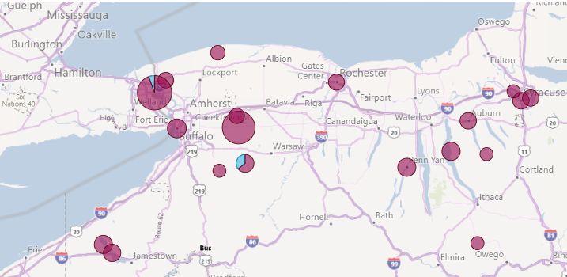
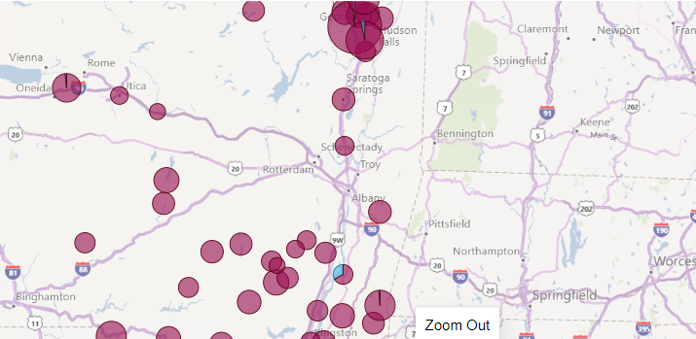
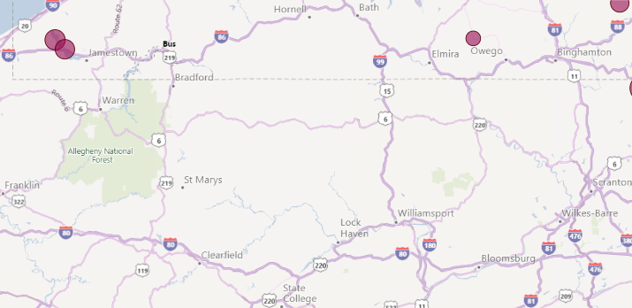
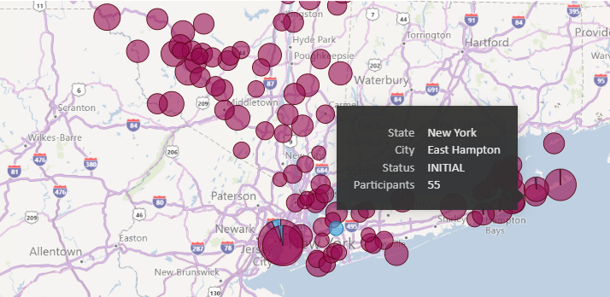
Basic Info – Summer Work

Slide 7
Basic Info – Intern/Trainee
Start Dates- Year Round
Housing
Types of Employment – Culinary, Food & Bev, Guest Services, Housekeeping supervisor, Tourism Mgmt, Winery operations, Baker, Restaurant Mgmt, Catering Mgmt, Waiting;Serving
Intern ~ 1,600 in NY (1st)
  Currently enrolled or graduated in last 12 months
Trainee ~2,200 in NY (2nd)
  Degreed, Professional Certificate or 5 years work experience
Cost – None but could help.

Slide 8

Eswatini
New Possibilities
Less Competition
Help Wanted

Slide 9



Partners

Slide 10

Eswatini
Know your material in advance
Anticipate common questions
Rehearse your responses
Maintaining composure during the Q&A session is essential for projecting confidence and authority. Consider the following tips for staying composed:
  Stay calm
  Actively listen
  Pause and reflect
  Maintain eye contact

Slide 11
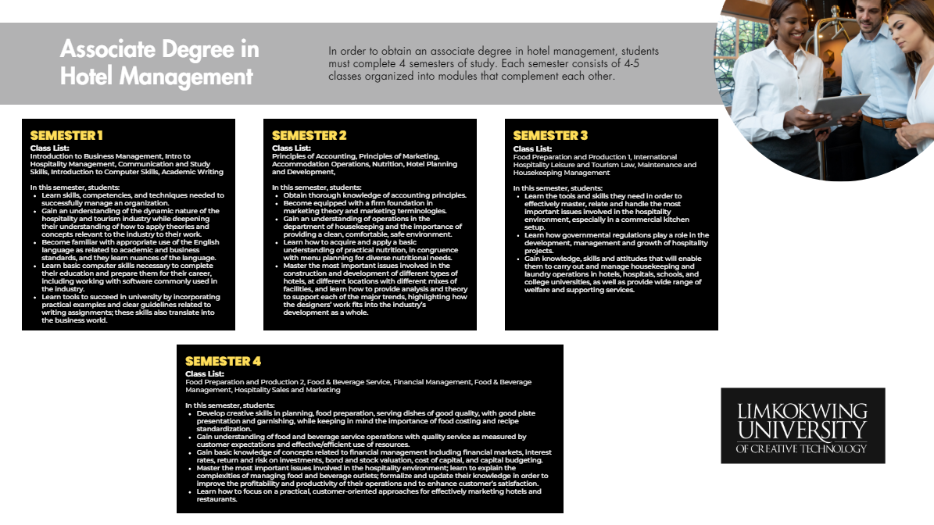
Eswatini
Know your material in advance
Anticipate common questions
Rehearse your responses
Maintaining composure during the Q&A session is essential for projecting confidence and authority. Consider the following tips for staying composed:
  Stay calm
  Actively listen
  Pause and reflect
  Maintain eye contact

Slide 12
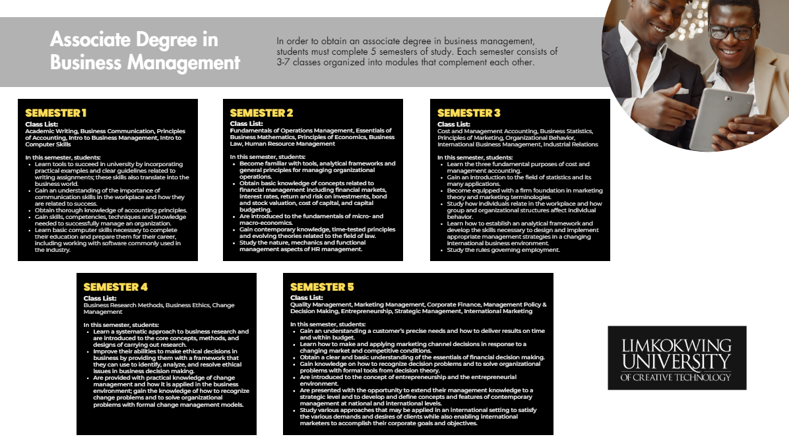
Eswatini
Know your material in advance
Anticipate common questions
Rehearse your responses
Maintaining composure during the Q&A session is essential for projecting confidence and authority. Consider the following tips for staying composed:
  Stay calm
  Actively listen
  Pause and reflect
  Maintain eye contact

Slide 13
chendricks@experienced-associates.com
QUESTIONS?
Housing
Second Jobs
Hours (amount and night)

Slide 14
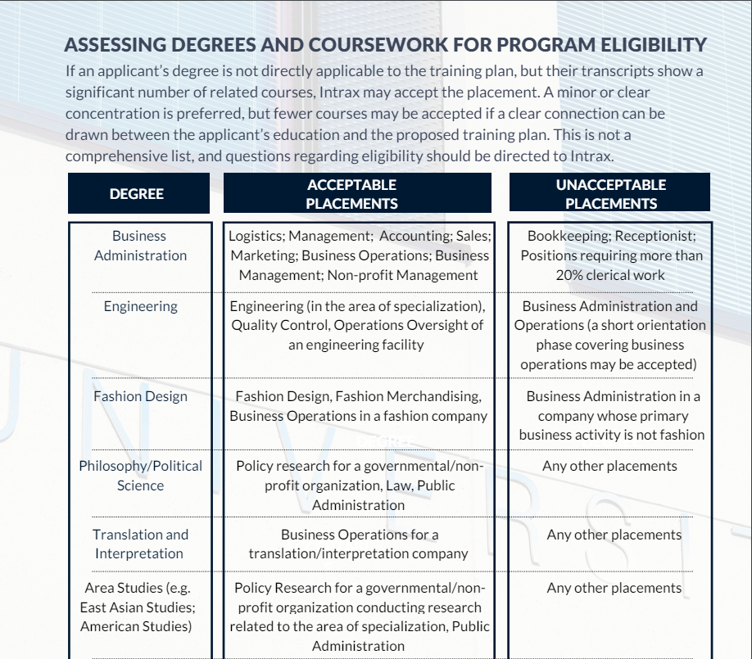
Dynamic delivery

Slide 15
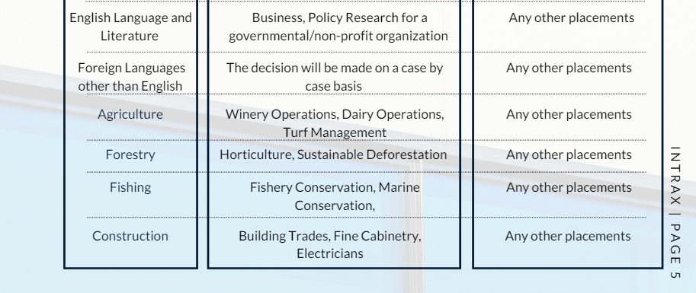

Slide 16
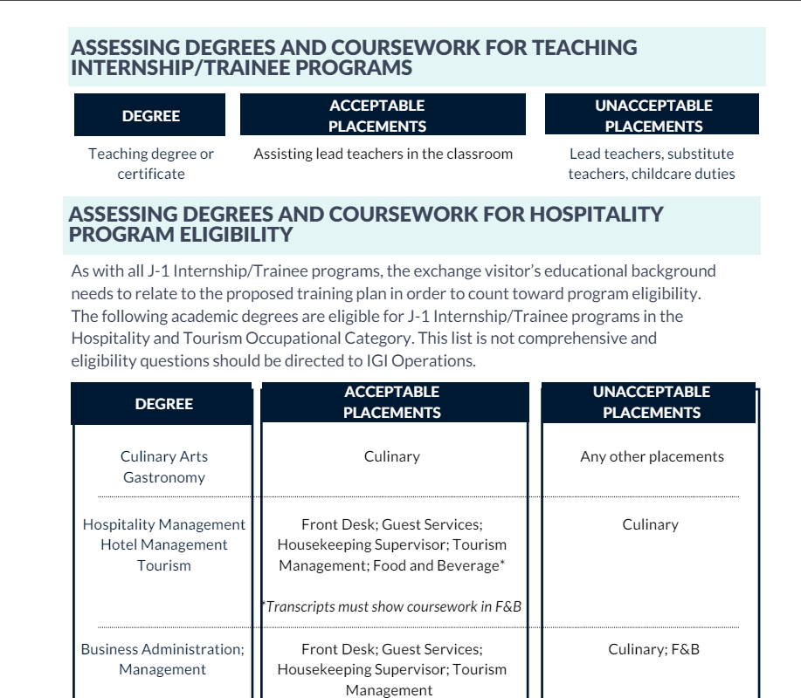

Slide 17
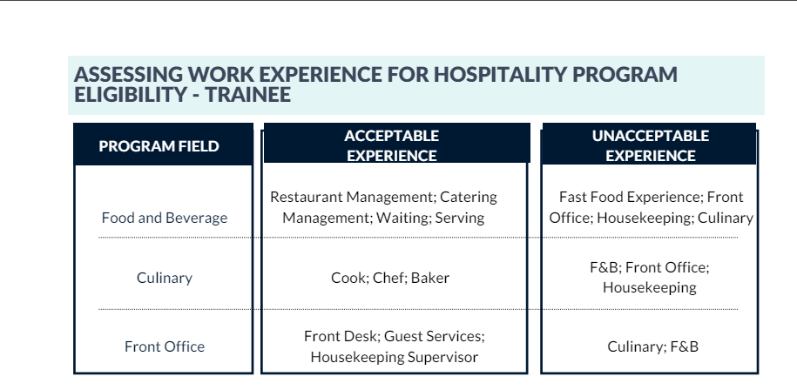

Slide 18
